Slide 1
Data-Scarce Animal Face Alignment via Bi-Directional Cross-Species Knowledge Transfer
Dan Zeng¹, Shanchuan Hong¹, Shuiwang Li², Qiaomu Shen¹, Bo Tang¹
¹Southern University of Science and Technology,
²Guilin University of Technology
Notes:
Hi, my name is Dan Zeng and very happy to share with you about our paper entitled “Data-Scarce animal face alignment via bi-directional cross-species knowledge transfer”.

Slide 2


Animal face alignment
Detect facial landmarks
Large significance
Better understanding animals
Promote their health
Less expensive to examinations
It remains largely unexplored!
Facial expression analysis
Animal pain detection
Facial tracking
Notes:
So to start with animal face alignment aims to detect facial landmarks. To illustrate, given a panda image, what we aim to do with animal face alignment is to precisely locate the keypoints around the panda’s eyes, nose and mouth.
This study holds substantial significance for a variety of applications, such as facial expression analysis, animal pain detection and facial tracking, ect. In a broad sense, the study of animal face alignment can help us better understanding animals and help promote their health. Also, it can serve as a less expensive alternative to traditional clinical examinations.
However, despite its promising applications and significant potential impact, I want to emphasize that animal face alignment remains largely unexplored.

Slide 3

Challenges
Large intra- and inter- species variations
Lack large-scale annotated data!!
Our focus: data-scarce animal face alignment
300W
AFLW
Menpo
…
AnimalWeb
Notes:
Now, let’s go deeper into the unique challenges that animal face alignment offers for research and development. First, there are large intra- and inter-species variations, which can be easily observed in several example faces. Second, lack large-scale annotated data for animal face alignment. There are quite a few large-scale datasets such as 300W, AFLW, Menpo, ect, but all are collected for human face alignment . And for animal face alignment, what we have up to now is only animalweb. Our research is particularly focused on addressing data-scarce animal face alignment, which we believe holds practical significant in real-world applications.

Slide 4
Challenges
Large intra- and inter- species variations
Lack large-scale annotated data!!
Existing solutions
Finetuning human face alignment model
Animal-specific face alignment (horse, sheep)
Utilize auxiliary information
Our solution (Meta-CSKT)
Leverage bi-directional cross-species knowledge transfer
Notes:
Next, let’s see how existing solutions address the challenges in animal face alignment? Some methods adapt existing models design for face alignment model by finetuning them using limited animal data. Some methods take a more specialized route, focusing on species-specific alignment for animals like horse, sheep, where data scarcity is less of an issue. Recent methods have also started to incorporate auxiliary information such as shared landmark semantic group prior, styleGAN prior, and labeled support images during testing to enhance small dataset face alignment.
In contrast to these methods, our method, termed Meta-CSKT, leverage bi-directional cross-species knowledge transfer. This method is particularly useful for overcoming the challenges associated with data-scarce in animal face alignment.

Slide 5
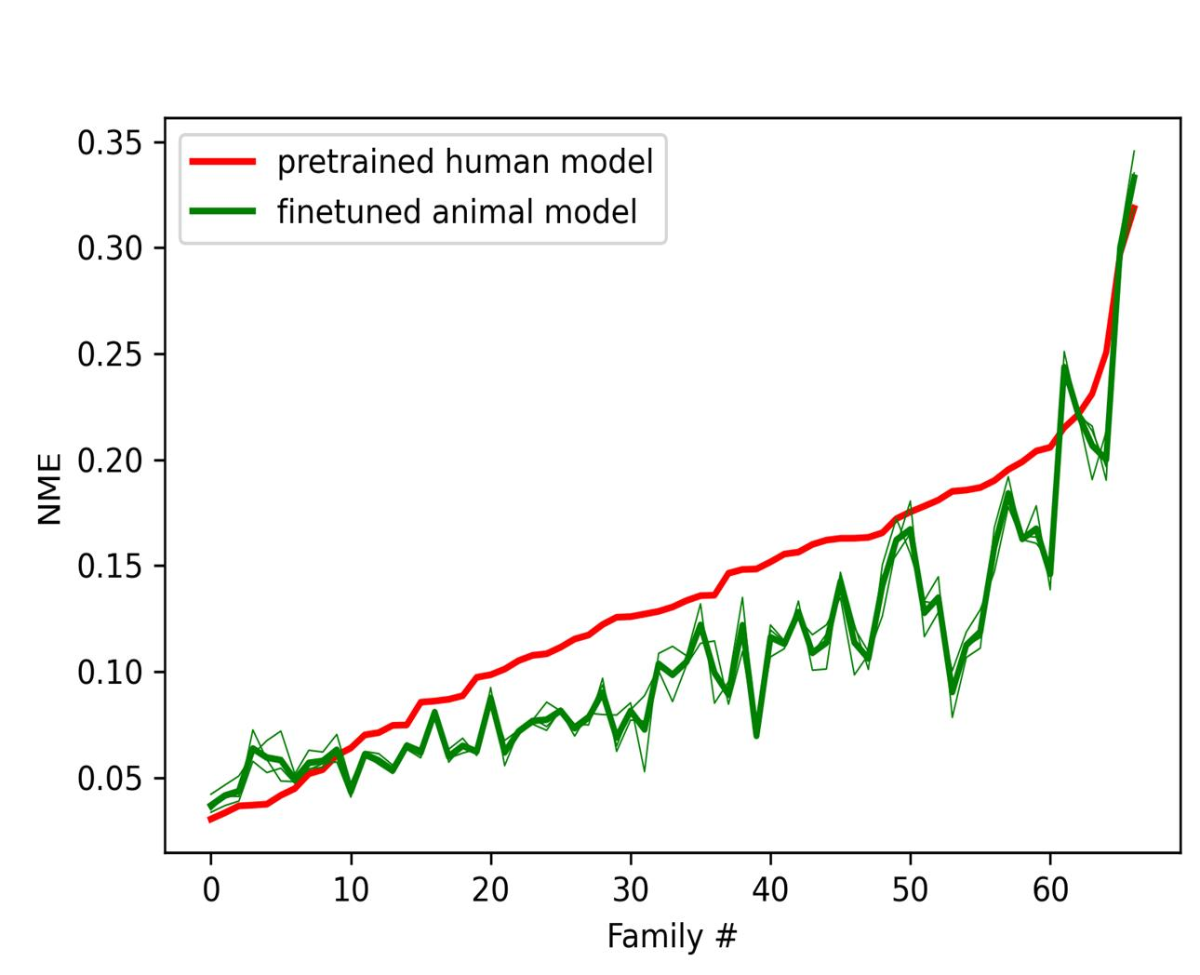
Motivation
Notes:
Here are alignment results for AnimalWeb by using 1 pretrained human model and 3 finetuned animal model which are sorted in ascending order based on NME by the human model

Slide 6
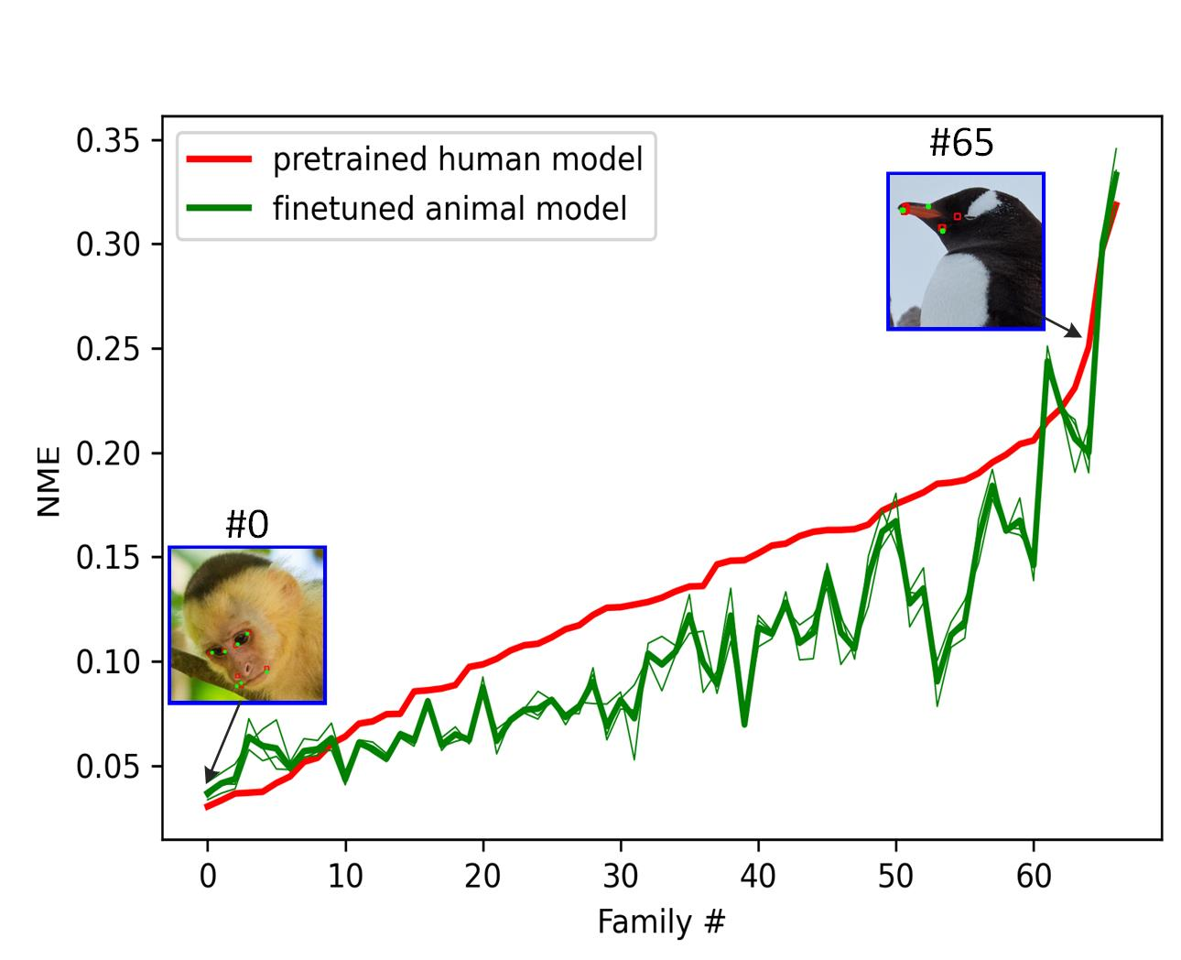
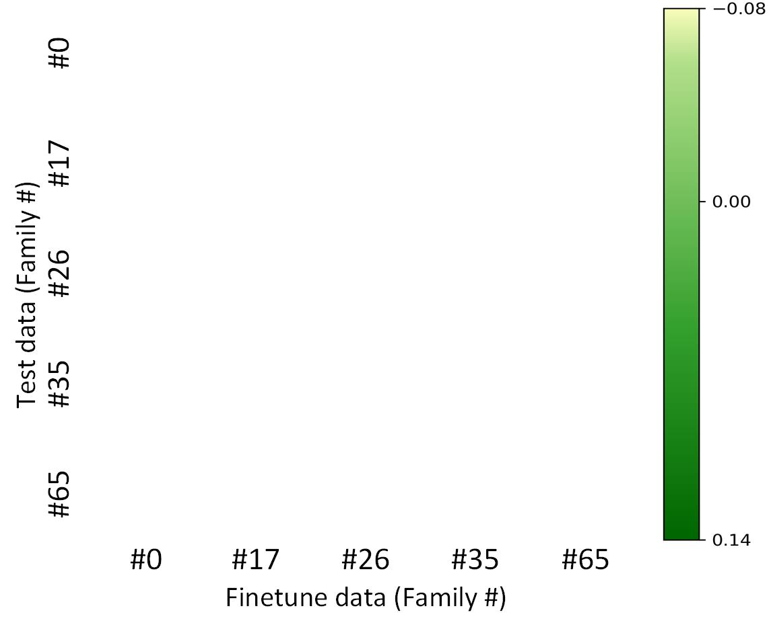
Motivation
NME Difference Confusion Matrix
Notes:
. The red curve is biased towards certain species such as monkey (family 0) that have a close shape or appearance to humans and produce poor results on less human-like species such as penguin (family 65). Finetuning the animal model does slightly improve the results, however, the gained accuracy is uneven across species. To go deeper, we take five species (0,17,26,35,65) sampled from Animalweb for experiments. We go further to observe the impact of finetune data on test data by this NME difference confusion matrix.

Slide 7
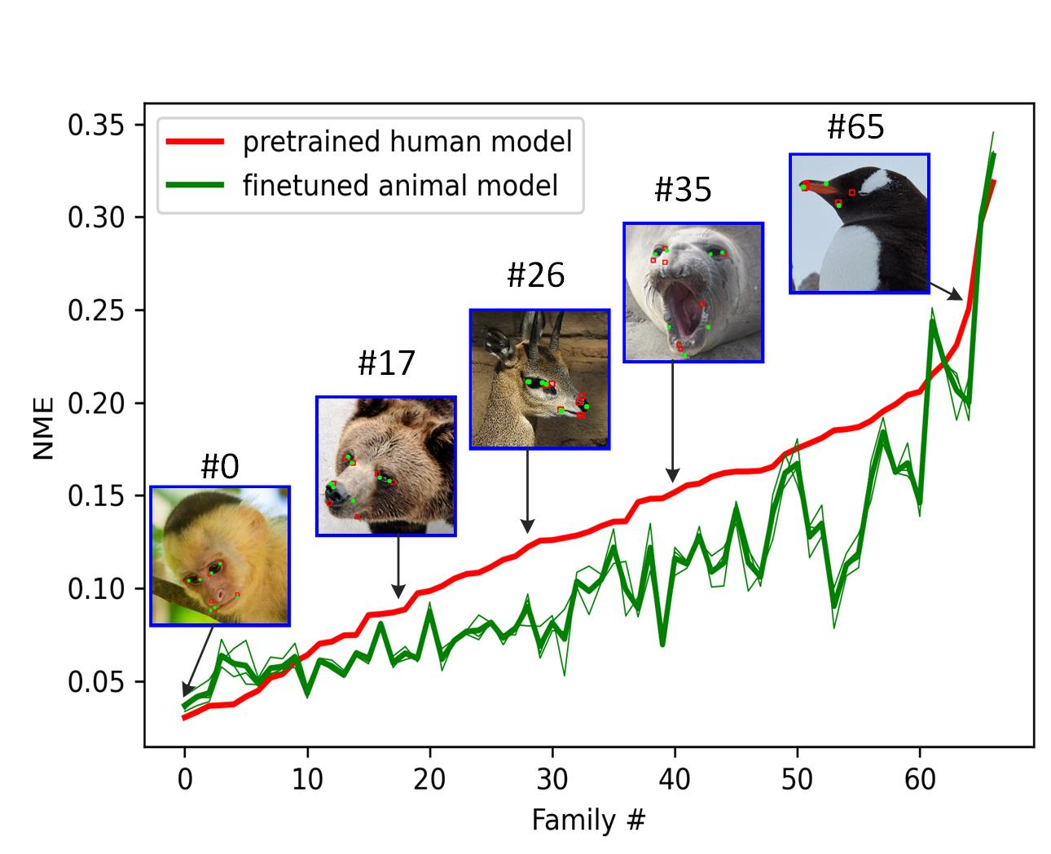
Motivation
NME Difference Confusion Matrix
Notes:
To go deeper, we take five species (0,17,26,35,65) sampled from Animalweb for experiments. We go further to observe the impact of finetune data on test data by this NME difference confusion matrix.

Slide 8
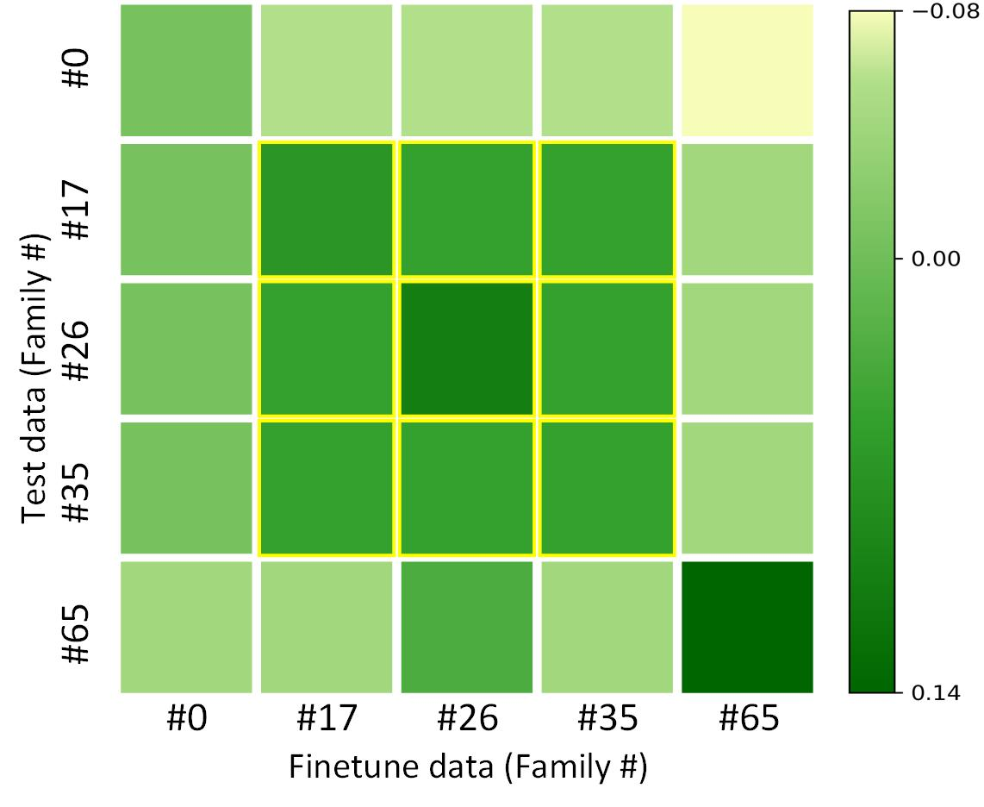
Motivation
NME Difference Confusion Matrix
Notes:
Specifically, we randomly select 40 images from each family as the finetune data, which are used to train the model. And the individual species of test data are used for evaluation. Here darker green indicates a large performance gain by finetuning.

Slide 9
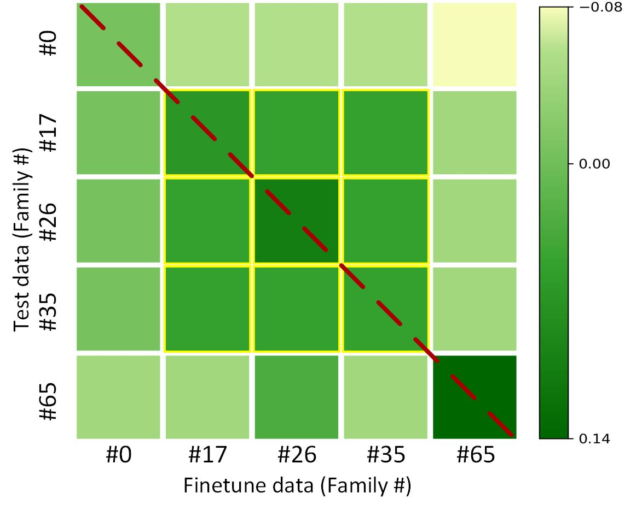
Motivation
NME Difference Confusion Matrix
Notes:
According to the confusion matrix, first, we observe that the diagonal elements show increased accuracy as expected. Specifically, species 65 has the darkest color and the species 0 has the lightest color. It makes sense as the species 0 can already aligned with human model and finetuning with more animals cannot lead to obvious better alignment.

Slide 10

Motivation
Knowledge sharing among animal species, which provides a fundamental premise for Meta-CSKT!!
NME Difference Confusion Matrix
Notes:
What surprised us is the center clustering submatrix in the middle. We can clearly observe performance gain for test species 17,26, and 35 even if we do not finetune data with the corresponding species. For example, finetuning the human model by using species 17 also leads to performance gains for species 25 and 26 in the test data. This means there are knowledge sharing among animal species, which actually provides a fundamental premise for Meta-CSKT to function well. This is the primary motivation for Meta-CSKT.

Slide 11

Motivation
Knowledge sharing among animal species, which provides a fundamental premise for Meta-CSKT!!
NME Difference Confusion Matrix
➖
➖
➖
➖
➖
➖
➖
➖
➖
➖
Notes:
Apart from that, we can also notice negative gain for finetuning certain species. For instance, using species 65 penguin, brings in performance drop for all other species in the test data. This provides another clue, we should not include animals like penguin for training as it harms the overall performance. In the context of semi-supervised learning, we should consider include rather accurate pseudo label such as species 0 as the labeled data and discard animals data like penguin. This comes with another key of our research, which is how to effectively utilize the unlabel data?

Slide 12
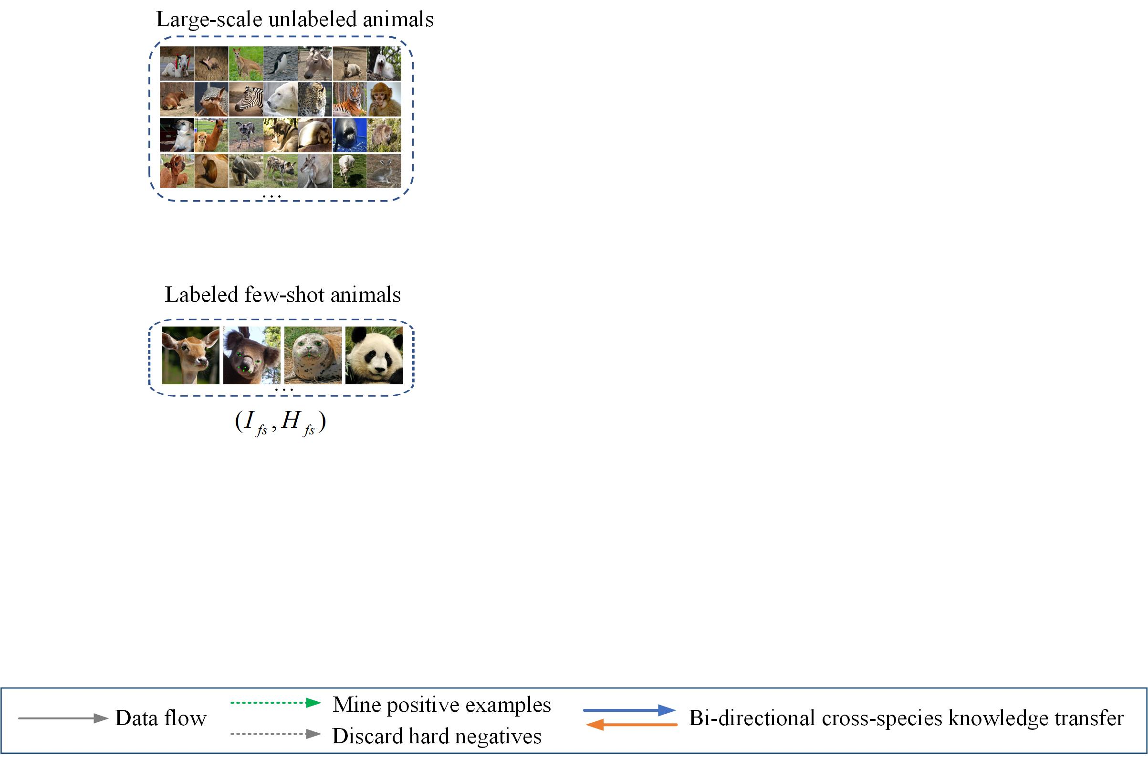
Meta-CSKT
Labeled data is SCARCE！
Notes:
Now, we move to our method design part. Labeled data is scarce, and what we have at hand is labeled few-shot animals with precise landmark annotations provided and large-scale unlabeled animals that are quite common and easy to collect.

Slide 13
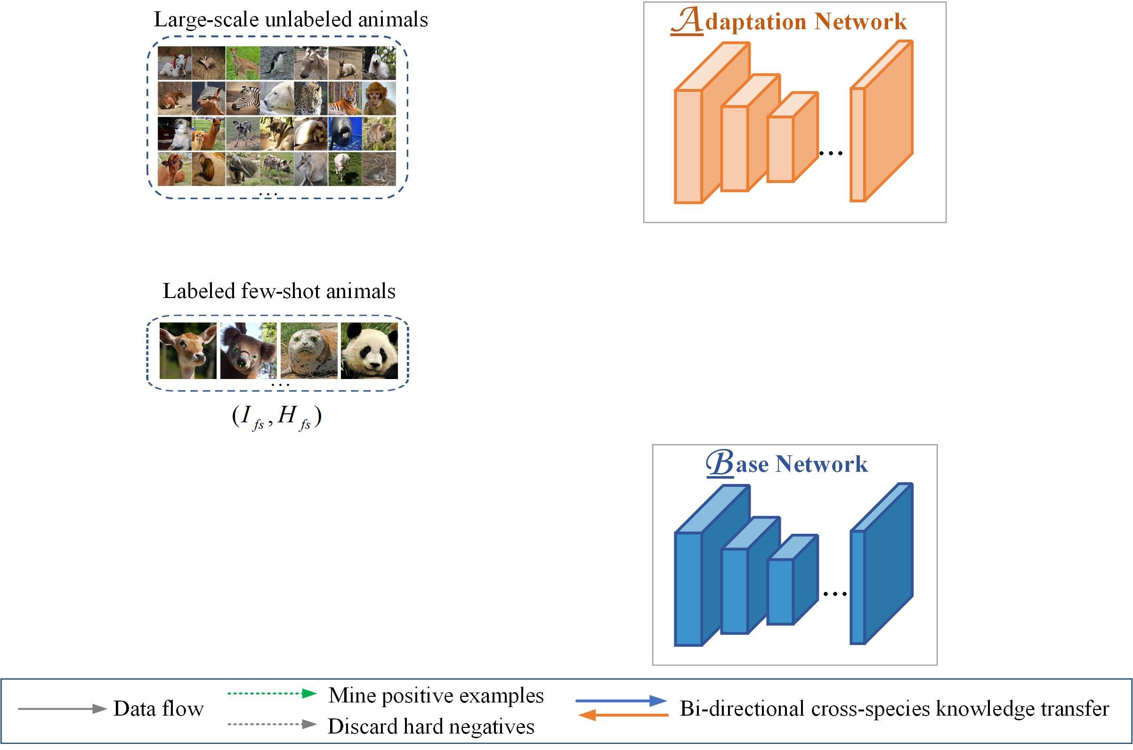
Meta-CSKT
Labeled data is SCARCE！
Two complement networks
Notes:
The proposed meta-cskt consists of two networks, which are base network and adaptation network. They are complement networks, which will be elaborately introduced in the following slides.

Slide 14
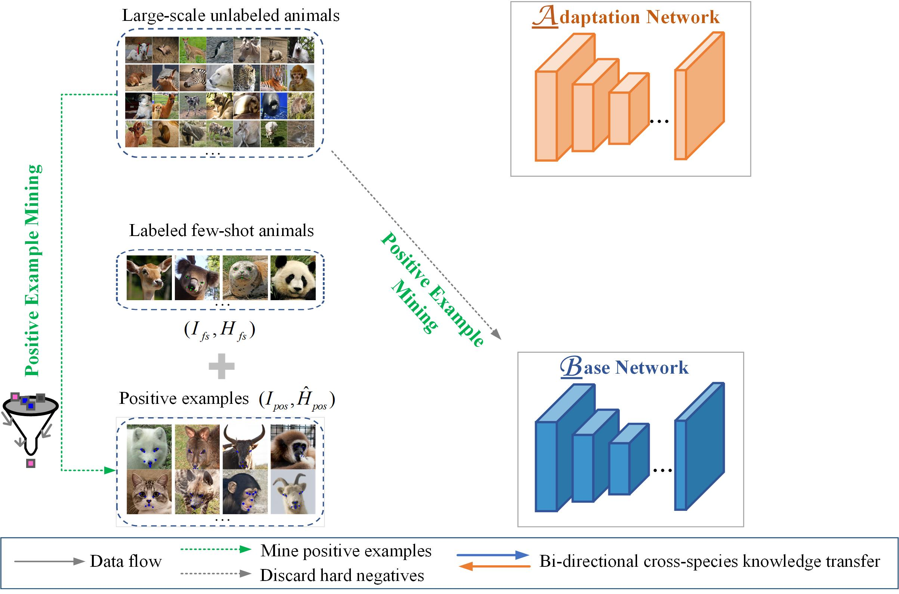
Meta-CSKT
Labeled data is SCARCE！
Two complement networks
Positive example mining :
Augment labeled data
Purify unlabeled data
Notes:
To effectively utilize unlabeled animals, we propose positive example mining, which augments the few-shot labeled data with many more positive examples while also purify unlabeled data by discarding negative samples such as penguin we mentioned before.

Slide 15
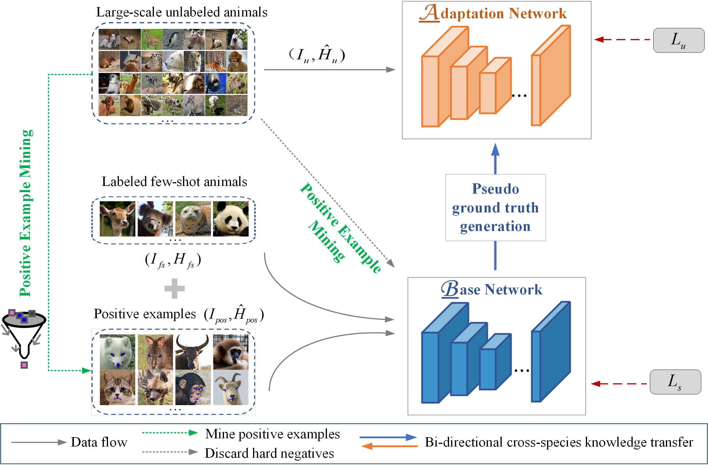
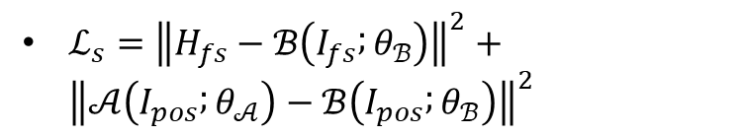
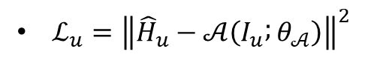
Meta-CSKT
Adaptation network:
$ℒ_{u}={\left\|{\hat{H}}_{u}−𝒜\left(I_{u} ; θ_{𝒜}\right)\right\|}^{2}$
Base network (1/2):
$ℒ_{s}={\left\|H_{fs}−ℬ\left(I_{fs} ; θ_{ℬ}\right)\right\|}^{2}+{\left\|𝒜\left(I_{pos} ; θ_{𝒜}\right)−ℬ\left(I_{pos} ; θ_{ℬ}\right)\right\|}^{2}$
Notes:
With pseudo ground truth generation, the base network generates pseudo label \hat{H}_{u} for large-scale unlabeled images I_{u}. Once these pseudo data are ready, the adaptation network is trained by using unsupervised loss L_{u}, which encourages two networks to predict similar heatmaps on unlabeled data. Meanwhile, base network is supervised by supervised loss on two types of data. One is the labeled few-shot data, the other is positive examples with the pseudo labels generated by adaptation network.

Slide 16
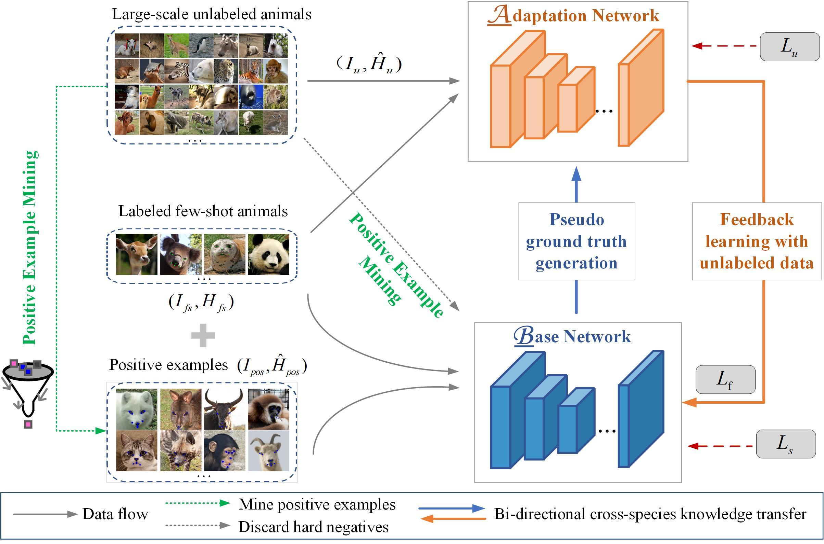
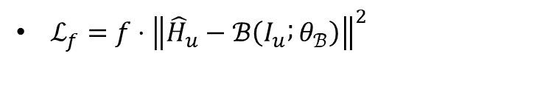
Meta-CSKT
Base network (2/2):
Feedback loss
$ℒ_{f}=f⋅{\left\|{\hat{H}}_{u}−ℬ\left(I_{u} ; θ_{ℬ}\right)\right\|}^{2}$
Notes:
We also employ feedback learning with unlabeled data to update base network. Specifically, we formulate the feedback loss as the product of two terms, in which the first term f is the feedback coefficient that determines the direction and strength of the update, the second term is the loss of the base network on unlabeled data.

Slide 17
Meta-CSKT
Base network (2/2):
Feedback loss
$ℒ_{f}=f⋅{\left\|{\hat{H}}_{u}−ℬ\left(I_{u} ; θ_{ℬ}\right)\right\|}^{2}$
Gradients of the “new” network on few-shot data
Gradients of the “old” network on large-scale unlabeled data
Notes:
In meta-cskt, the intuition behind the base network update is the relationship between new adaptation network on few-shot data and gradients of old network on large-scale unlabeled data. In this way, we define f. The sign of f will determine the direction of the update, and the absolute value will determine its strength.

Slide 18
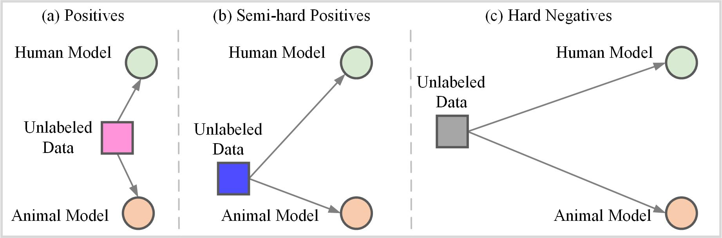
Positive example mining
If the ground truth is known, it is easy to identify three types of unlabeled data
Notes:
We go further to introduce positive example mining. To represent how close the predicted heatmaps of two models are to the ground truth for an unlabeled data, we use a triplet. If the ground truth is known, it is easy to identity three types of unlabeled data, which are positives, semi-hard positives and hard negatives.

Slide 19
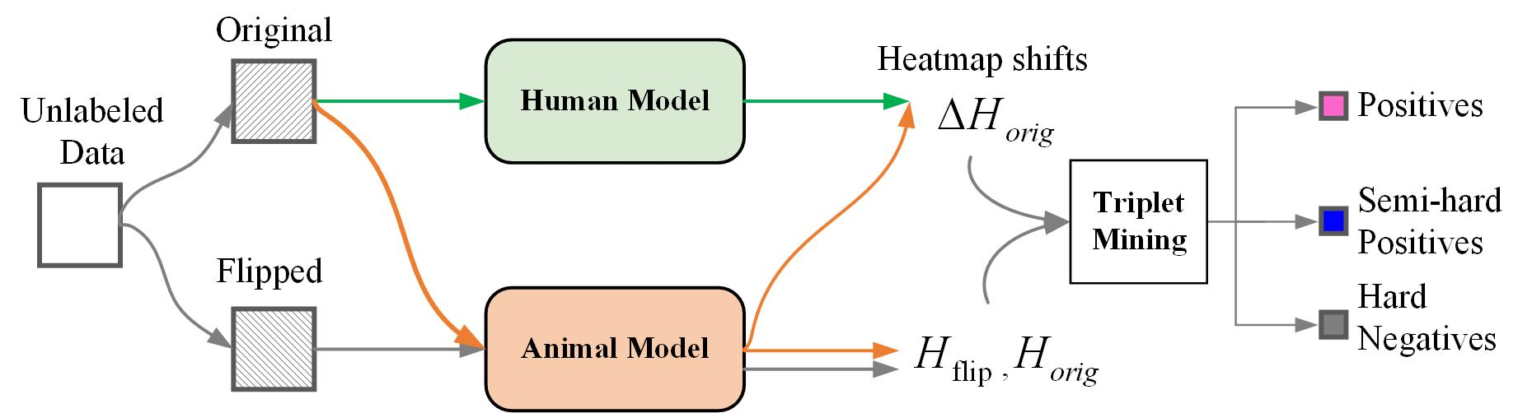
Positive example mining
No ground truth is available!
If , the unlabeled data is hard negative
If , the unlabeled data is positive
Elsewise, the unlabeled data is semi-hard positives
Notes:
However, in practice, no ground truth is available for unlabeled data.
First, we use the flipping relationship to filter out the hard negatives. That means, if the predicted heatmaps of original image and the flipped version fail to preserve the flipping relationship, these data are hard negative. Moreover. We use the heatmap shifts between different models to determine the difficulty of aligning different animals. When the delta_H_{orgin} is less than given positive threshold, the unlabeled data is positive. The rest of data is semi-hard positives.

Slide 20
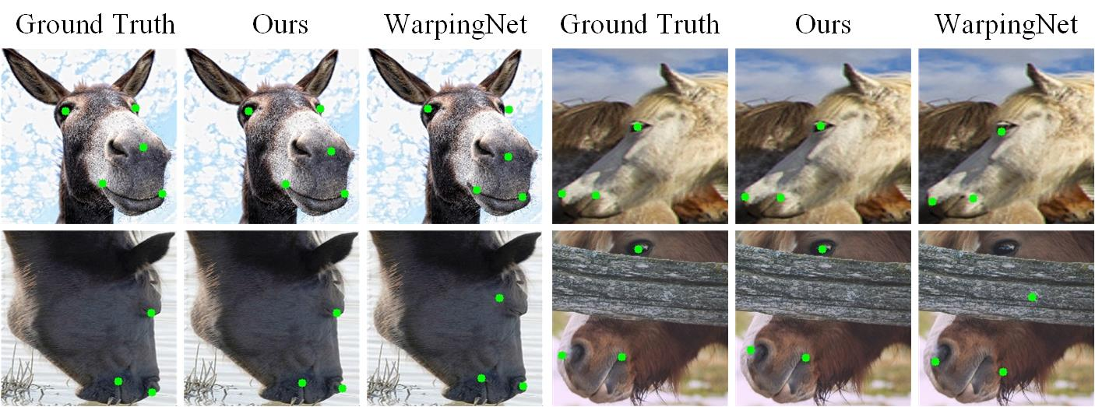
Evaluation on Horse Facial Keypoint dataset
Robust to occlusion and large pose variations
Notes:
To evaluate the effectiveness of our proposed method, we conduct extensive experiments. Here are results on horse facial keypoint datasets, it is obvious that our method is more robust to occlusion and large pose variations on these example faces.

Slide 21
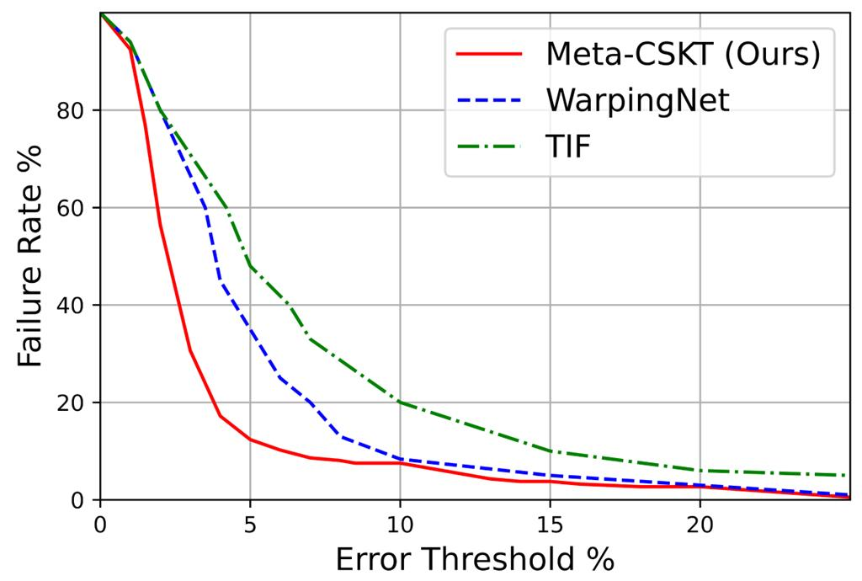
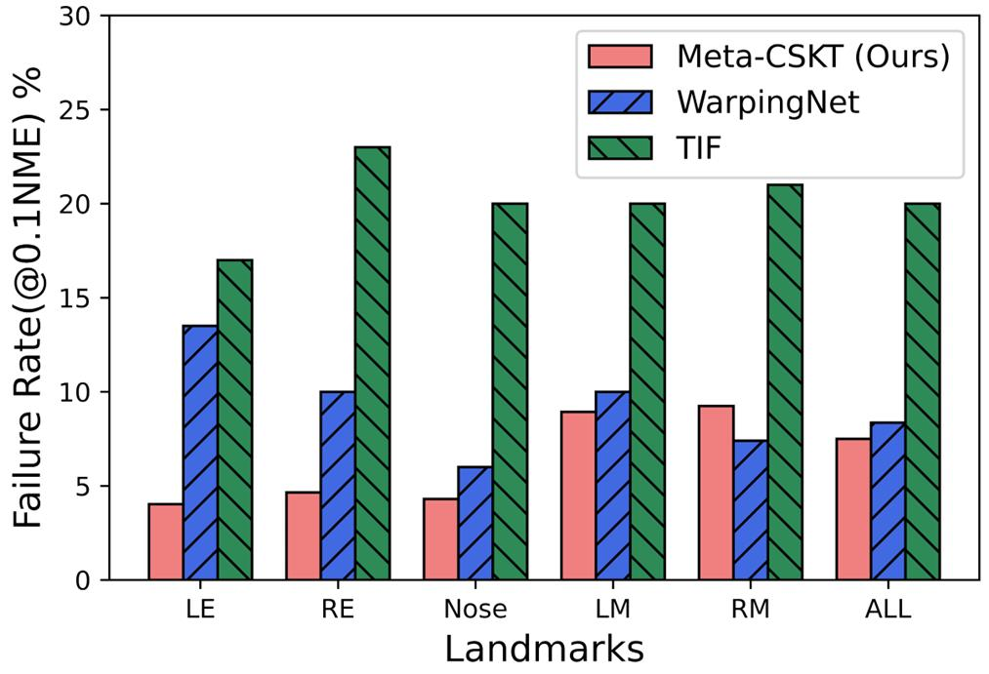
Evaluation on Horse Facial Keypoint dataset
Notes:
Similarly, we can see that our method shows consistently superior accuracy across all thresholds, especially at low NME error. We also report performance of each landmark, and the results show our method significantly reduces the failure rate, especially for the left eye and right eyes, regardless of challenges including occlusion and large pose variations.

Slide 22
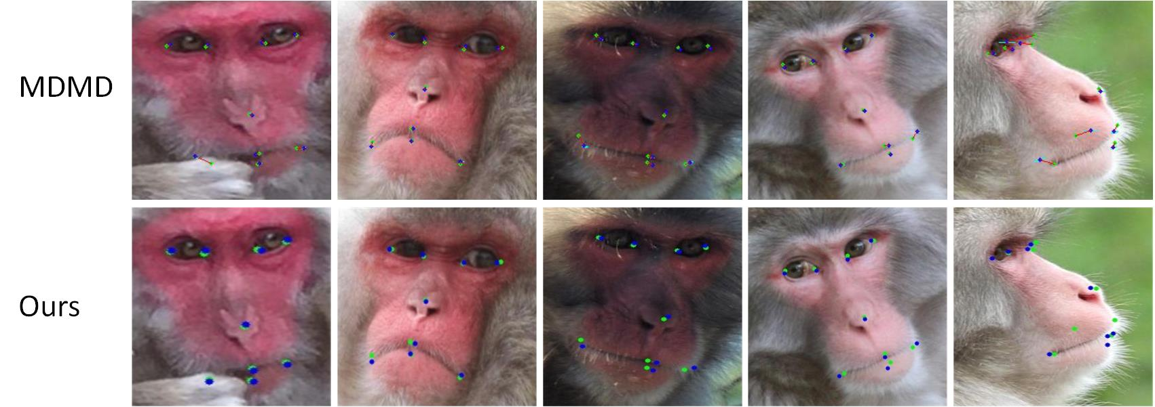
Evaluation on Japanese Macaque Species
Models | MDMD Base | MDMD 300W | ViTPose+B | Ours
NME | 3.66 | 3.44 | 4.69 | 2.96
Notes:
Evaluation on Japaness Macaque species indicate that our method demonstrates significantly lower NME error, outperforming the compared methods by a large margin. We also show the alignment results on several illustration examples for comparison. The ground truth landmarks and predicted landmarks are indicated as green and blue.

Slide 23
Evaluation on AnimalWeb
Models (Known) | # Labeled Image | NME | Models (Unknown) | # Labeled Image | NME
HG2 | 17.96K | 5.22 | HG2 | 17.62K | 6.14
HG3 | 17.96K | 5.12 | HG3 | 17.62K | 5.96
Ours | 40 | 5.61 | Ours | 40 | 7.44
 | 80 | 5.55 |  | 80 | 7.21
Our method achieves comparable performance while utilizing significantly fewer labeled data
Known species setting: comparable
Unknown species setting: acceptable gap (1%)
Images: 40 or 80 versus 17+K; Images per species: 0.11 or 0.22 versus ~50
Notes:
Go further, we compare our method with state-of-the-art baseline models that trained with large-scale dataset on the AnimalWeb. As the results shown, our method achieves comparable performance while utilizing significantly fewer labeled data. Specifically, for known species setting, the NME results are comparable which is 5.22 vs 5.55. For unknown species setting, we can still get acceptable gap with 1% difference in terms of NME error. I want to emphasize that the labeled images used for training are quite different, which are 40 or 80 images on our side versus more than 17K used in compared method. Or 0.11 or 0.22 images per species versus 50 images per species.

Slide 24
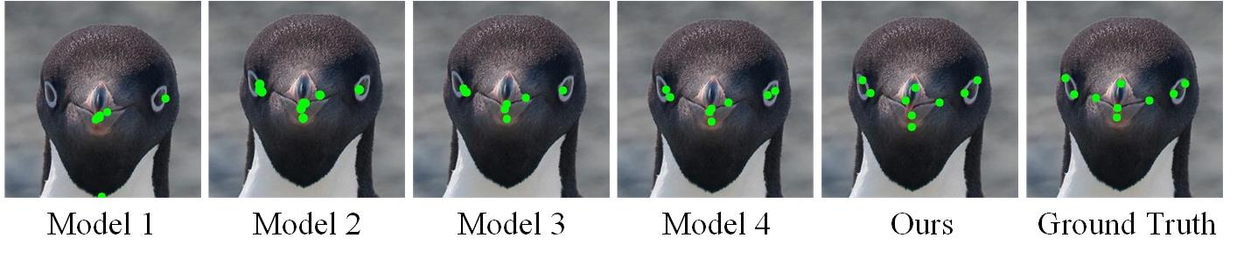
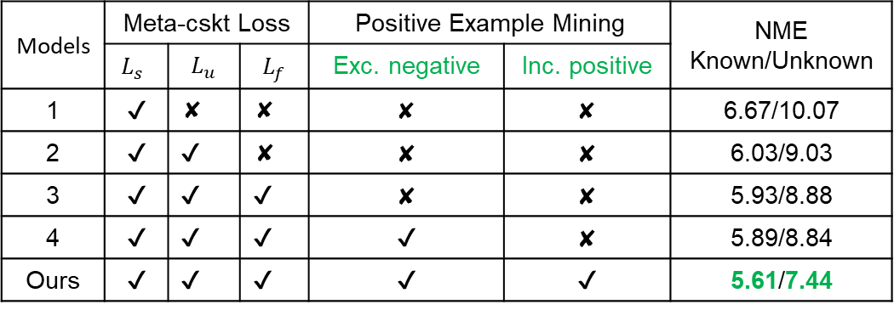
Effect of Meta-CSKT design
Models | Meta-cskt Loss |  |  | Positive Example Mining |  | NME Known/Unknown
 | $$L_{s}$$ | $$L_{u}$$ | $$L_{f}$$ | Exc. negative | Inc. positive
1 | ✔ | ✘ | ✘ | ✘ | ✘ | 6.67/10.07
2 | ✔ | ✔ | ✘ | ✘ | ✘ | 6.03/9.03
3 | ✔ | ✔ | ✔ | ✘ | ✘ | 5.93/8.88
4 | ✔ | ✔ | ✔ | ✔ | ✘ | 5.89/8.84
Ours | ✔ | ✔ | ✔ | ✔ | ✔ | 5.61/7.44
Getting better
Notes:
In the end, we systematically explore the effect of Meta-csk design. As results shown, every individual design contributes to the performance improvement. Not only loss functions but positive example mining altogether yield the lowest NME in both known and unknown species setting.

Slide 25
Conclusion
Knowledge sharing among animals motivates Meta-CSKT, the first to leverage bi-directional cross-species knowledge transfer for data-scarce animal face alignment
We propose positive example mining to effectively utilize unlabeled data: augment labeled data and purify unlabeled data
Extensive experiments on three datasets demonstrate the superiority of our method for animal face alignment by using only a few labeled images
Notes:
Here is the take away. First,. Second,. Last,

Slide 26
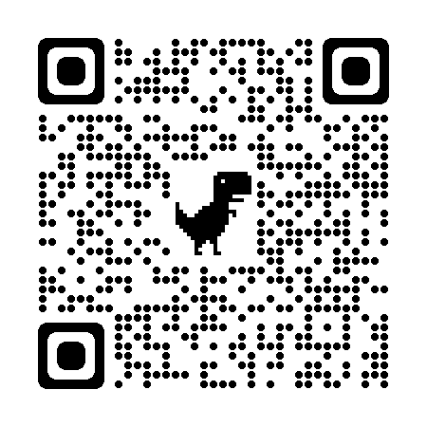
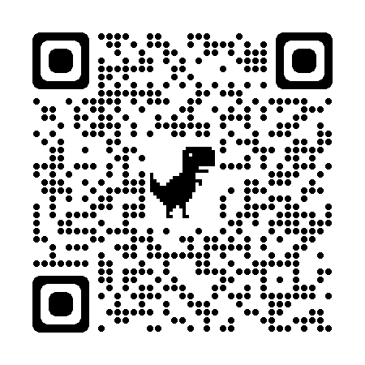
Please refer to our paper and the project page for more details and analyses: https://www.danzeng.org/about/ , https://github.com/danzeng1990/Meta-CSKT
Paper
Project page
Thanks for attention
Contact: zengd@sustech.edu.cn
Notes:
That’s all. Thanks for attention

